Slide 1
A.Mahalakshmi 821721104029 Computer science and engineering3rd year sir Issac Newton College of engineering and technology

Slide 2
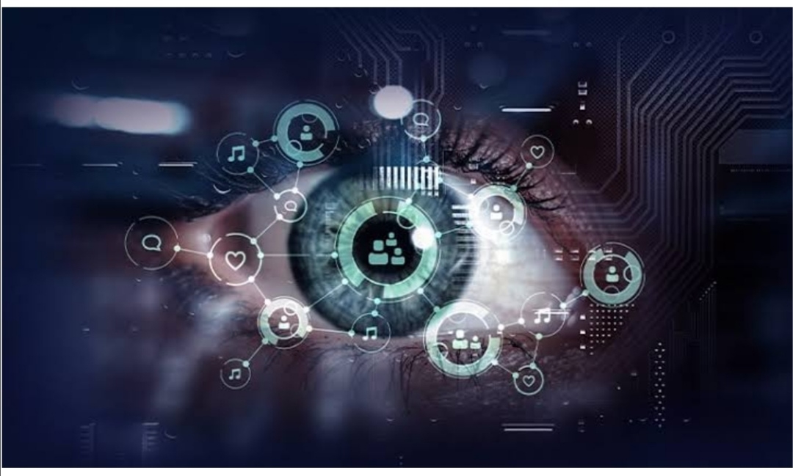
COMPUTER VISION (RNN)

Slide 3
AGENDA
Creating an agenda for a computer vision project involving recurrent neural networks (RNNs) using Python could be structured as follows:Introduction to Computer Vision and RNNs:Brief overview of computer vision and its applications.Introduction to recurrent neural networks (RNNs) and their relevance in sequential data processing.Setting Up the Development Environment:Installation of necessary Python libraries (e.g., TensorFlow, Keras, OpenCV).Setting up a virtual environment for the project.Data Preparation:Collecting and preprocessing the dataset for the computer vision task.Exploratory data analysis (EDA) to understand the dataset's characteristics.Building the RNN Model:Designing the architecture of the RNN model for the computer vision task.Choosing appropriate RNN layers (e.g., LSTM, GRU) and parameters.Compiling the model with suitable loss function and optimizer.

Slide 4
Project overview
Project Title: Computer Vision-based Object Detection and Recognition1. Problem Statement: Develop a computer vision system capable of detecting and recognizing objects in images or video streams. The system should be able to identify and classify various objects within the scene accurately and efficiently.

Slide 5
Problem statement
1. **Data Preprocessing**: Preprocess the video data by extracting frames and converting them into a suitable format for input into the model. Perform data augmentation techniques to increase the diversity of the training data.
2. **Feature Extraction**: Use a pre-trained convolutional neural network (CNN) such as ResNet or VGG to extract spatial features from individual frames of the videos. These features will capture spatial information such as shapes and patterns within each frame.
3. **Temporal Modeling**: Utilize a recurrent neural network (RNN) architecture, such as LSTM or GRU, to model the temporal dependencies between frames in the video sequence. The RNN will analyze the sequence of spatial features extracted from the frames to capture the temporal evolution of the action being performed.
4. **Model Training**: Train the combined CNN-RNN model using the preprocessed video data. Employ techniques such as transfer learning to leverage the knowledge learned by the pre-trained CNN on large-scale image datasets

Slide 6
Who are the end users
: Medical professionals and researchers utilize computer vision for medical imaging analysis, disease diagnosis, surgical assistance, and patient monitoring. End users include doctors, radiologists, surgeons, and healthcare institutions.: Medical professionals and researchers utilize computer vision for medical imaging analysis, disease diagnosis, surgical assistance, and patient monitoring. End users include doctors, radiologists, surgeons, and healthcare institutions.Manufacturing and Robotics: Manufacturers utilize computer vision for quality inspection, defect detection, object recognition, robotic guidance, and production automation. End users include manufacturing companies, factory operators, and robotics engineers.Surveillance and Security: Law enforcement agencies, security firms, and public safety organizations use computer vision for video surveillance, facial recognition, crowd monitoring, and threat detection. End users include security personnel, law enforcement officers, and government agencies.

Slide 7
Your solution
Who are the end users of computer visionEnd Users: Doctors, radiologists, surgeons, healthcare institutions.Solution: Medical imaging analysis for disease diagnosis, surgical assistance, patient monitoring, and treatment planning. For example, using computer vision to detect abnormalities in X-rays, MRIs, or CT scans.

Slide 8
The wow in your solution
I’m glad you liked it! If you have any specific questions about the solution or need further assistance with computer vision using RNNs in Python, feel free to ask.
The combination of computer vision and recurrent neural networks (RNNs) opens up possibilities for tasks such as image captioning, video analysis, and sequence prediction based on visual data.
If you’re working on such a project, it’s great to hear that you found the solution impressive! If you need any specific advice or assistance with your project, feel free to ask.

Slide 9
Modelling
Data Preparation:Collect and preprocess your image data.Convert images into a suitable format for input into the RNN.
This often involves resizing, normalizing pixel values, and possibly converting to grayscale.
Model Architecture:Define your RNN model architecture. You can use LSTM (Long Short-Term Memory) or GRU (Gated Recurrent Unit) cells for the recurrent part
Combine the RNN with convolutional layers to extract features from the images.
This combination is often referred to as a CNN-RNN architecture.Optionally, you can add additional layers like fully connected layers or attention mechanisms depending on your specific task

Slide 10
RESULTS
To showcase the results of a computer vision RNN project in Python, you typically want to visualize performance metrics such as accuracy, loss, and possibly some sample predictions. Here’s how you can do it:
Training Progress Visualization: Plot the training and validation loss and accuracy over epochs to understand how the model is learning. You can use libraries like Matplotlib to create these plots.
Confusion Matrix: For classification tasks, create a confusion matrix to see which classes the model is confusing with each other. This helps in understanding where the model is making mistakes.
Sample Predictions: Choose some random samples from the test set, feed them into the model, and visualize the predictions alongside the ground truth labels to see how well the model is performing.
Performance Metrics: Compute additional performance metrics such as precision, recall, and F1-score to get a deeper understanding of the model’s performance.

